Slide 1
Kidney stone detection
Image processing project by Nourhan amr 2022/05080

Slide 2
Goal:
The goal of this project is to detect and analyze kidney stones in medical images using image processing techniques. This project helps in automating the identification and measurement of stones, which can aid in medical diagnosis and treatment planning.

Slide 3
Project Description:
The images are first pre-processed using noise removal techniques, followed by binary thresholding to segment the regions of interest. Contours are then detected, and properties like area, perimeter, and eccentricity are calculated. Stones are identified based on these properties, and contours are drawn on the images along with labels. The processed images visually highlight the stones, helping in the analysis of size and shape for further medical evaluation.

Slide 4
Table of contents
01
02
03
04
05
Image acquisition
Image restoration
Image Segmentation
Represntation and Description
Object recognition

Slide 5
01
Image Acquisition

Slide 6
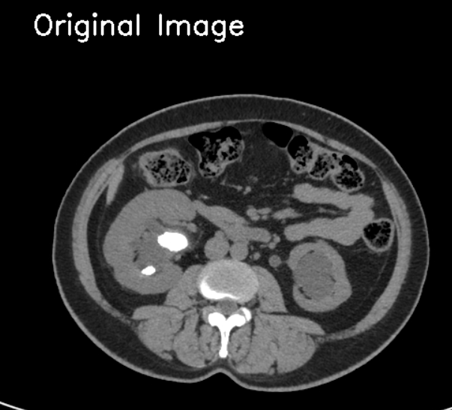
Load kidney images from the drive

Slide 7
02
Image Restoration

Slide 8
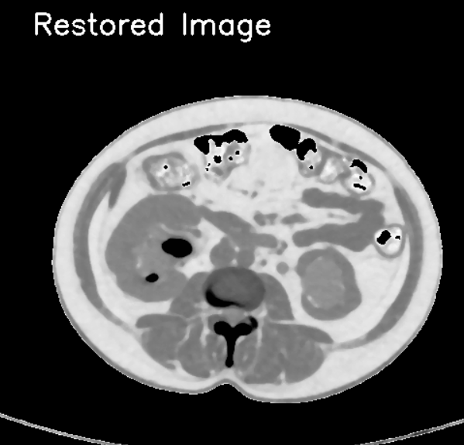
Restore any noise from the image.

Slide 9
03
Image Segmentation

Slide 10
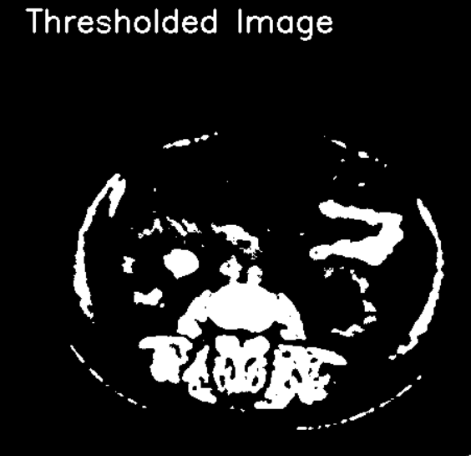
Segment the kidney region and stone from background using region based segmentation (Threshold)

Slide 11
04
Representation and Description

Slide 12
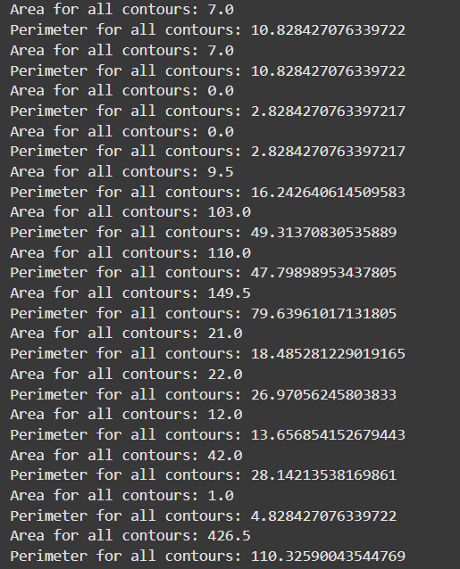
Extract features and calculate contours (area and perimeter)

Slide 13
05
Object Recognition

Slide 14
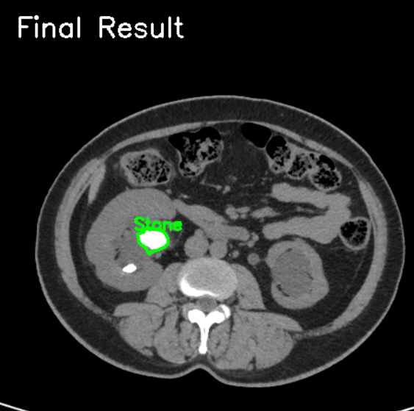
Calculate eccentricity to detect the stones in a correct way and label stones.

Slide 15
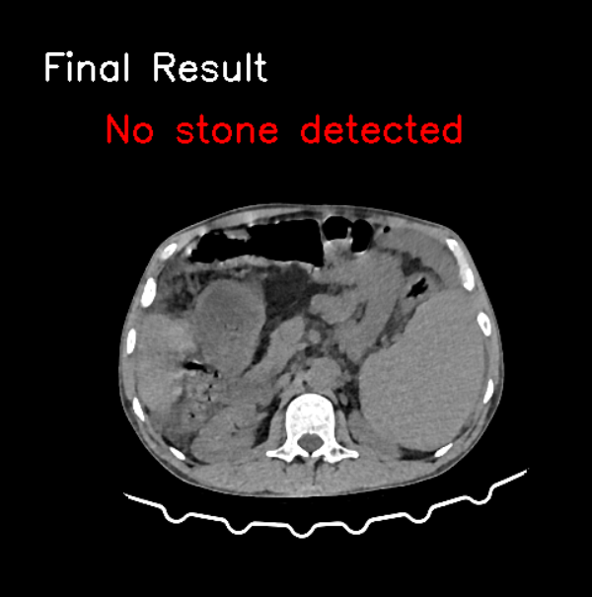
Calculate eccentricity to detect the stones in a correct way and label stones.

Slide 16
Thank you

